Slide 1
Minimum Spanning Trees
EECS 233

Slide 2

Minimum Spanning Tree
A minimum spanning tree (MST) of a connected (weighted) graph has the lowest total cost among all possible spanning trees.
MST may not be unique
Applications: finding a MST could be used to
  determine the shortest highway system to connect a set of cities
  calculate the smallest length of cables needed to connect a network of computers
  Group communication on the Internet (cost = hop distance to reduce bandwidth consumption)
6
3
3
1
3
2
2
2
1
5
3
3

Slide 3
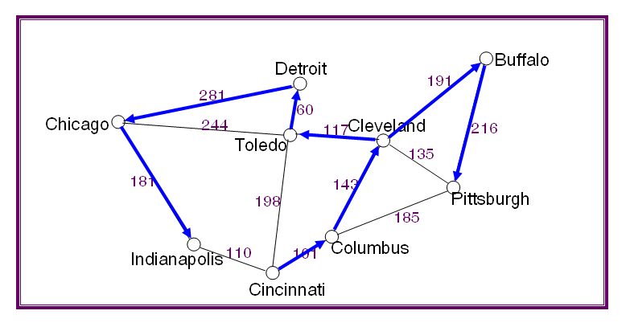
Recall: Depth/Breadth-First Spanning Trees
Depth-First traversal from Cincinnati: is it an MST?
Cincinnati
Columbus
Cleveland
Buffalo
Toledo
Pittsburgh
Detroit
Chicago
Indianapolis

Slide 4

Recall: Depth/Breadth-First Spanning Trees
Breadth-First traversal from Cincinnati: is it an MST?
Cincinnati
Columbus
Toledo
Indianapolis
Cleveland
Pittsburgh
Detroit
Chicago
Buffalo

Slide 5
Recall: Shortest path spanning tree
Shortest path tree from Buffalo – is it an MST?
Detroit
Buffalo
191
281
60
Chicago
244
117
Cleveland
216
Toledo
135
181
143
198
Pittsburgh
185
Indianapolis
110
101
Columbus
Cincinnati

Slide 6

How to find A Minimum Spanning Tree?
Key insight: if we divide the vertices into two disjoint subsets A and B, then the lowest-cost edge joining a vertex in A to a vertex in B – call it (a, b) – must be part of the MST.
Proof by contradiction:
  assume there is an MST (call it T) that doesn’t include (a, b)
  T must include a path from a to b, so it must include another edge (a’, b’) that connects subsets A and B with a path a to a’ to b’ to b
  adding (a, b) to T introduces a cycle
  removing (a’, b’) gives a spanning tree with lower
  cost, which contradicts the original assumption.
6
3
3
1
3
2
2
2
1
5
3
3
Notes:
A and B must still be connected; so let’s consider this path. It has an edge (a’, b’) that connects the blue and red subgraphs and has higher cost than (a.b).

Slide 7
Prim’s Algorithm
Begin with the following subsets:
  A = any one of the vertices
  B = all of the other vertices
Repeatedly select the lowest-cost edge (a, b) connecting a vertex in A to a vertex in B and do the following:
  add (a, b) to the spanning tree
  update the two sets: A = A U {b}, B = B – {b}
Continue until A contains all vertices.

Slide 8
Prim’s Algorithm (starting from Buffalo)
The algorithm will maintain the sets A and B
Final result: the set of edges forming an MST
Detroit
Buffalo
191
281
(1)
(3)
60
Chicago
244
117
Cleveland
216
Toledo
(2)
135
181
143
(4)
(8)
198
(5)
Pittsburgh
185
110
(6)
Columbus
Indianapolis
101
(7)
Cincinnati

Slide 9
Prim’s Algorithm (starting from Cincinnati)
The same minimum spanning tree, but the order in which we include edges is different
Detroit
Buffalo
191
281
(8)
(5)
60
Chicago
244
117
Cleveland
216
Toledo
(4)
135
181
(6)
(7)
143
(3)
198
Pittsburgh
185
(1)
Columbus
Indianapolis
110
101
(2)
Cincinnati

Slide 10
Prim’s Algorithm
Notation:
c(x,y): link cost from node x to y;
∞ if not direct neighbors
C(v): current estimate of cost-to-connect v to A
p(v): predecessor node along path from source to v
A: set of nodes added to MST
u: starting node
1 Initialization:
2 A = {u}
for all other nodes v
if v adjacent to u then
C(v) = c(u,v)
p(v) = u
6 else C(v) = ∞
7
8 Loop
9 find w not in A such that C(w) is a minimum
10 add w to A
11 update C(v) for all v adjacent to w and not in A :
C(v) = min( C(v), c(w,v) )
p(v) = w
15 until all nodes are in A
5
v
3
w
2
5
u
2
1
z
3
1
2
x
y
1

Slide 11
Prim’s vs. Dijkstra’s Algorithms
1 Initialization:
2 A = {u}
3 for all nodes v
if v adjacent to u then
C(v) = c(u,v)
p(v) = u
6 else C(v) = ∞
7
8 Loop
9 find w not in A such that C(w) is a minimum
10 add w to A
11 update C(v) for all v adjacent to w and not in A :
C(v) = min( C(v), c(w,v) )
p(v) = w
15 until all nodes are in A
1 Initialization:
2 N = {u}
3 for all nodes v
if v adjacent to u then
D(v) = c(u,v)
p(v) = u
6 else D(v) = ∞
7
8 Loop
9 find w not in N such that D(w) is a minimum
10 add w to N
11 update D(v) for all v adjacent to w and not in N :
D(v) = min( D(v), D(w) + c(w,v) )
p(v) = w
15 until all nodes are in N'
5
v
3
w
2
5
u
2
1
z
3
1
2
x
y
1

Slide 12
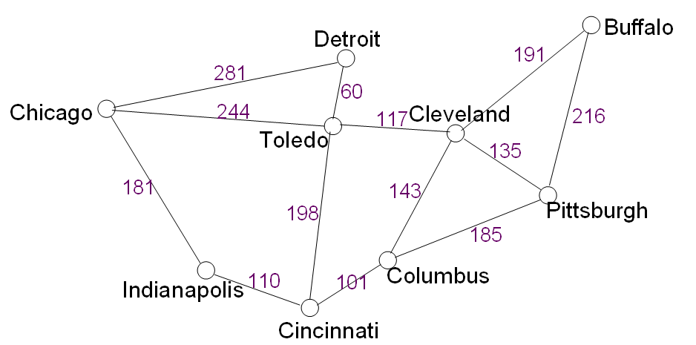
Intuitive Comparison of Dijkstra’s vs. Prim’s
Both Dijkstra’s and Prim’s expand the search circle by one vertex at a time, until all vertices are included
Dijkstra’s includes the one with the shortest distance to the source
  Shortest-path tree
Prim’s includes the one with the shortest distance to any of those already included
  Minimum spanning tree
Dijkstra’s
Prim’s

Slide 13
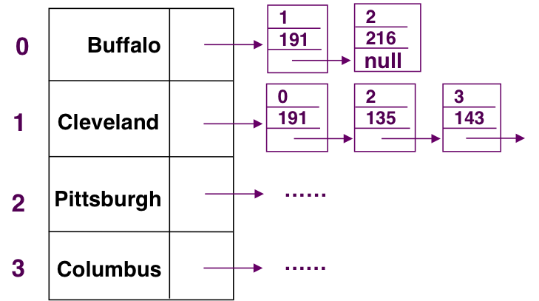
Prim’s Algorithm: Complexity
1 Initialization:
2 A = {u}
3 for all nodes v
if v adjacent to u then
C(v) = c(u,v)
p(v) = u
6 else C(v) = ∞
7
8 Loop
9 find w not in A such that C(w) is a minimum
10 add w to A
11 update C(v) for all v adjacent to w and not in A :
C(v) = min( C(v), c(w,v) )
p(v) = w
15 until all nodes are in N'
// V iterations
// Check of the total
of up to E edges
// O(V) to build the heap
// V iterations
// logV to reorg the heap after w’s removal
// A step per every link (E total); logV
per step to reorganize the heap
Overall complexity is O(V + E + VlogV + ElogV)=O((E+V)logV) =O(ElogV)

Slide 14
Back to the running time…
So far we considered running time of specific algorithms
  Big-O style abstractions to characterize/compare inherent quality of algorithms (irrespective of the machine running it)
What about inherent complexity of a problem?
Can we say that one problem is inherently more complex than another?
  E.g., even the best algorithm for problem 1 would run slower than (some) algorithm for problem 2?

Slide 15
Traveling Salesman Problem
A salesperson needs to travel to a number of cities to visit clients, and wants to do so as efficiently as possible.
I.e., they take a tour.
  A tour is a path that begins at some starting vertex, passes through every other vertex once and only once, and returns to the starting vertex. (The actual starting vertex doesn’t matter.)
Traveling Salesman Problem (TSP): find the tour with the lowest total cost
  TSP algorithms assume the graph is complete, but we can assign infinite costs if there isn’t a direct route between two cities.
  Note: an incomplete graph may not have a tour

Slide 16
TSP Example: Sparse Graph
In this graph, a Chicago salesman can find only one tour
Detroit
Buffalo
191
281
60
Chicago
244
117
Cleveland
216
Toledo
135
181
143
198
Pittsburgh
185
Indianapolis
110
101
Columbus
Cincinnati

Slide 17
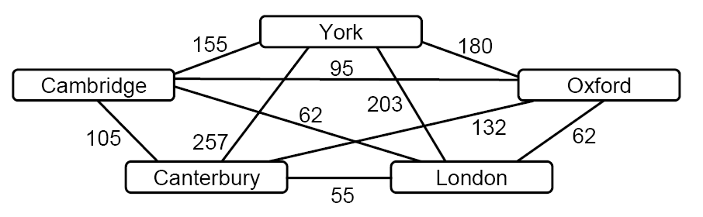
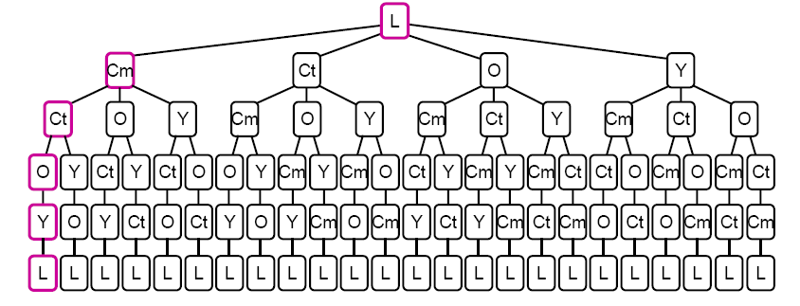
TSP Example: Dense Graph
In this example, we have more candidate solutions (due to full connectivity), and we need to perform an exhaustive search of all possible tours.

Slide 18
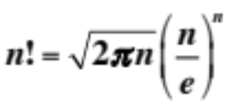
TSP Example
One method is to use DFS to traverse the entire state-space search tree.
  The leaf nodes correspond to possible solutions.
  For n cities, there are (n – 1)! leaf nodes in the tree
Problem: exhaustive search requires exponential running time
  Example: when n = 14, (n – 1)! = over 3 billion
  Less-than-exponential-time solution to TSP problem is unknown!
In a large graph, the problem of finding the optimal tour can be really difficult (meaning very expensive to do so)

Slide 19
Classes of Problems
Polynomial problems (and algorithms solve the problem in polynomial time), i.e., P problems
  Linear time
  O(NlogN) time
  Quadratic running time
  …
  O(N¹⁰⁰)
  …
But some problems are so difficult that we do not know a polinomial solution
  Not Polynomial time, i.e., NP problems
  TSP is an example of an exponential time problem, that we only know how to solve by exhaustive search
  No one knows if P=NP!
Homework: watch https://www.youtube.com/watch?v=VOsKA3ISMyI

